Slide 1
Group 6 Project
( EggEbb Team)
Unimaginable Super
Magic App
Use case+sequence diagram
Prototype

Slide 2

Outline
Recap
&
Summary
Old
VS.
New
Prototype
Questions

Slide 3




Recap
Ideation from last presentation
“
App name：
ePost App 2.0
Goal：
Improve Chunghwa Post’s older version of the App
- make sure that no one has difficulties in managing
their own account.
“
1
2
3
4
e動郵局
(ePost)
Security App

Slide 4
Recap
Log in
Transaction
3
1
2
Bitcoin transaction
Customer Service
Account information searching
4
10
Overall
ideas
Security&personal data
Design personal stamp
5
9
Package tracking
Receipt lottery
8
7
6
Payment
Postage calculation
Interest/exchange rate inquiry
Interface
Notes:
不用改

Slide 5
Old v.s. New

Slide 6
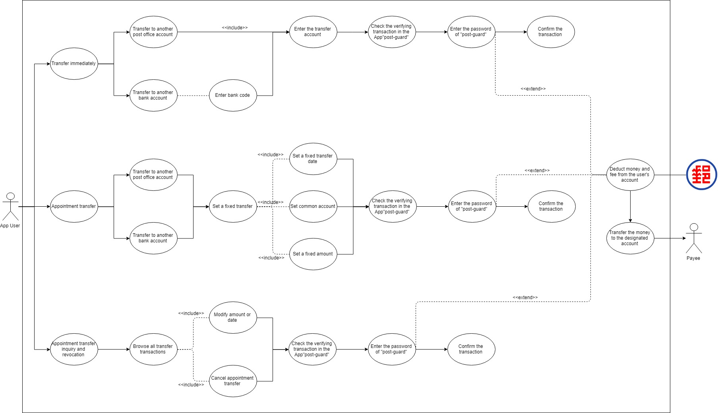
Idea 1 Transaction
Before—Use case diagram

Slide 7
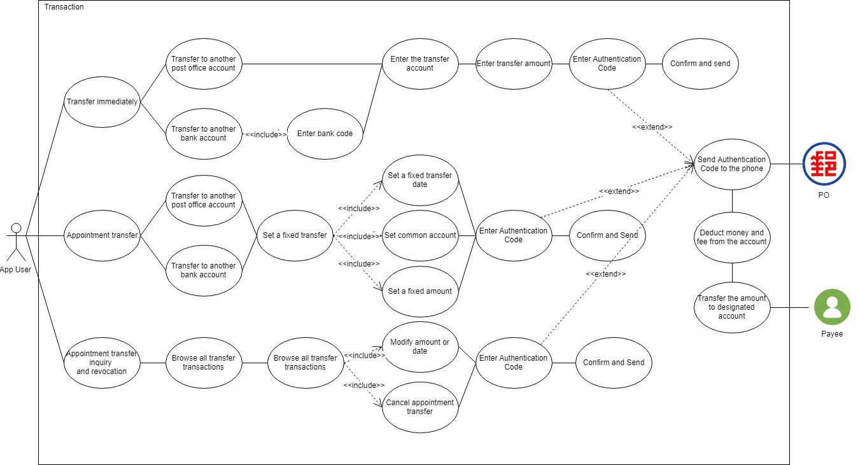
Idea 1 Transaction
After—Use case diagram

Slide 8
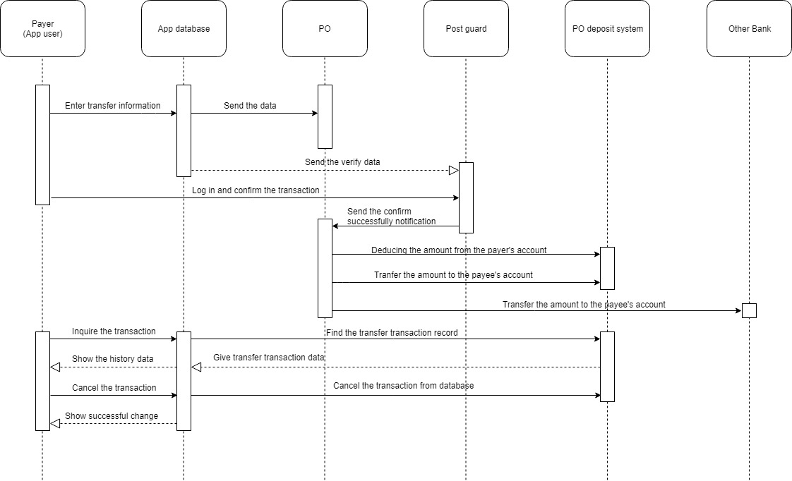
Idea 1 Transaction
Before—Sequence diagram
Sequence diagram
Sequence diagram

Slide 9
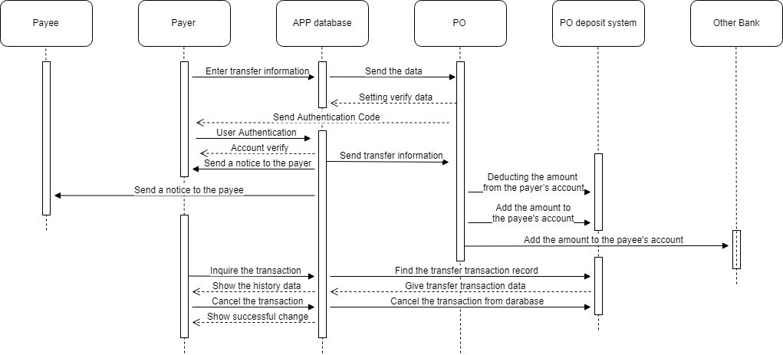
Idea 1 Transaction
After—Sequence diagram
Sequence diagram
Sequence diagram

Slide 10
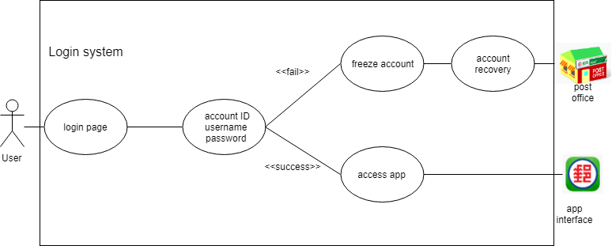
Idea 2 Log in
Before—Use case diagram

Slide 11
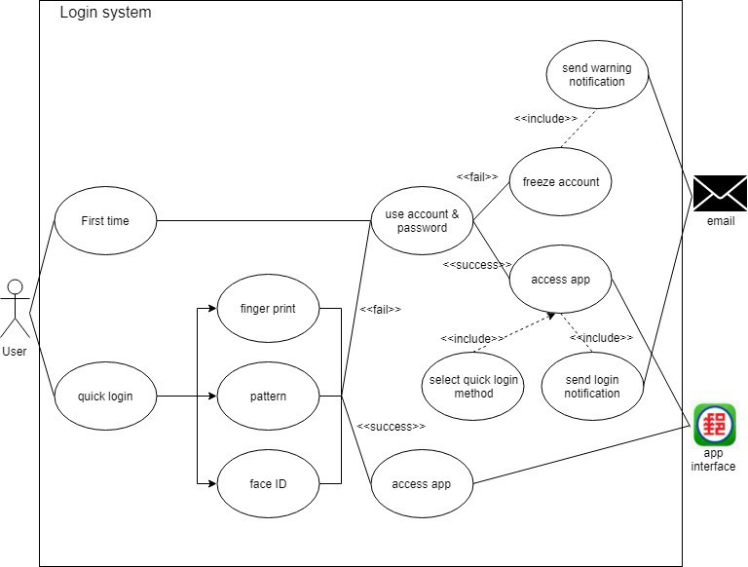
Idea 2
Log in
After—Use case diagram

Slide 12
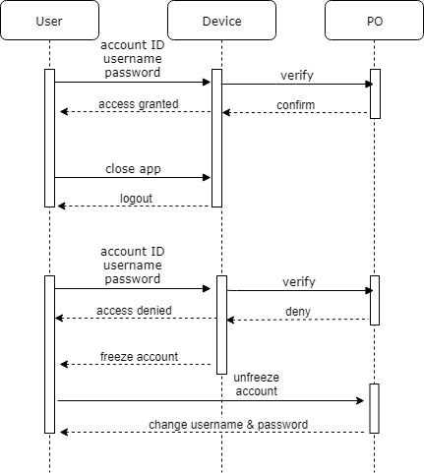
Idea 2
Log in
Before—Sequence diagram

Slide 13
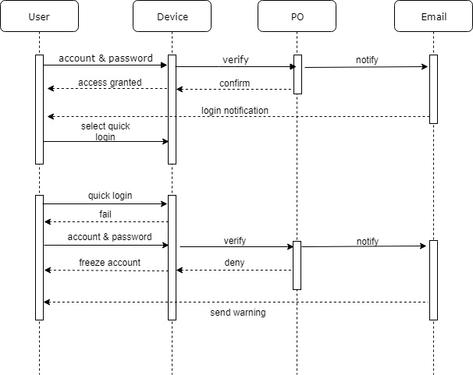
Idea 2
Log in
After—Sequence diagram

Slide 14
Difference
Transaction
Delete the use of ‘post-guard’
Use the verification code for the safety consideration
Log in
Add the ‘quick log-in’
Send the warning message when the account is frozen
Sequence diagram
Sequence diagram

Slide 15
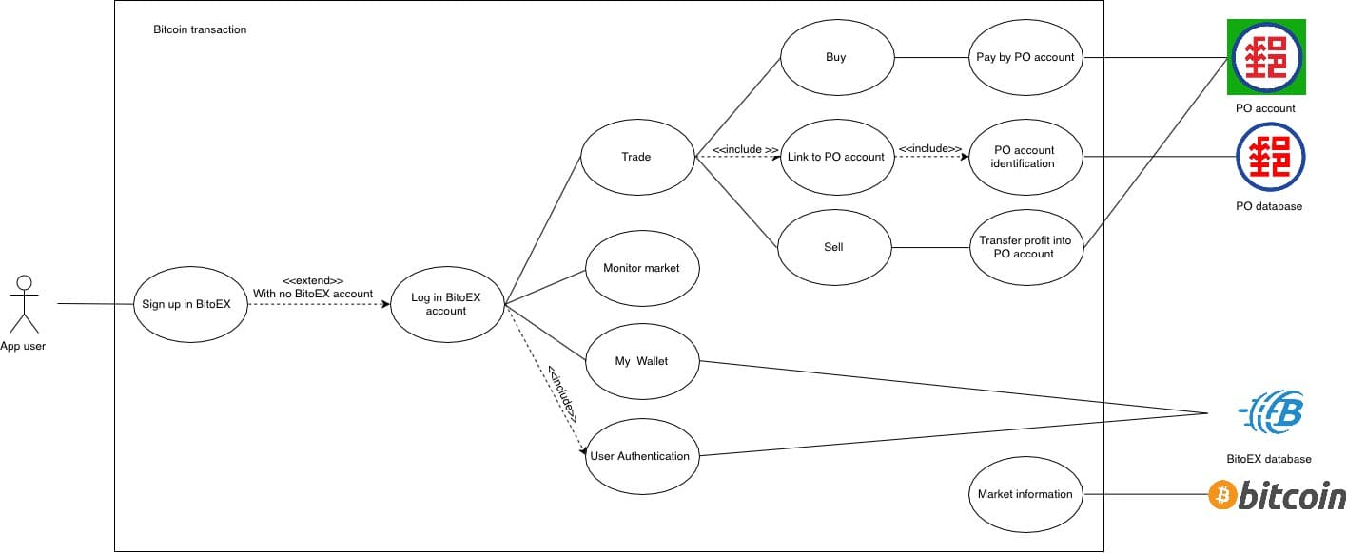

Idea 3 Bitcoin Transaction
Use case diagram
MaiCoin
MaiCoin
MaiCoin
M
MaiCoin database

Slide 16
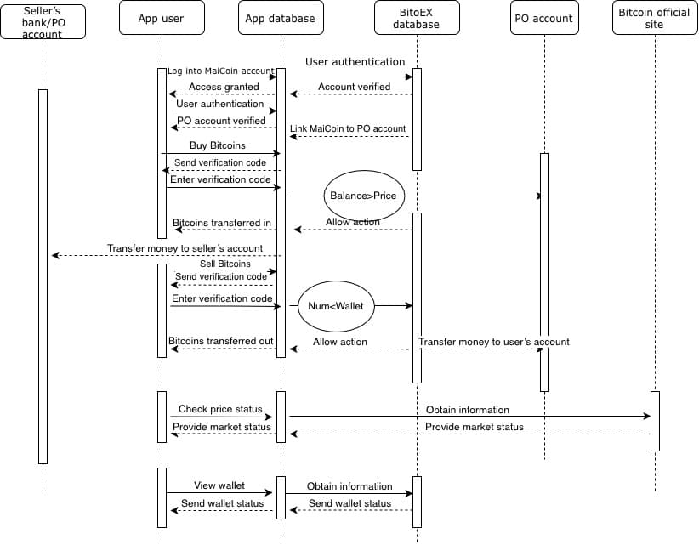
Idea 3
Bitcoin
Transaction
Sequence diagram

Slide 17
Prototype

Slide 18
Bitcoin

Slide 19
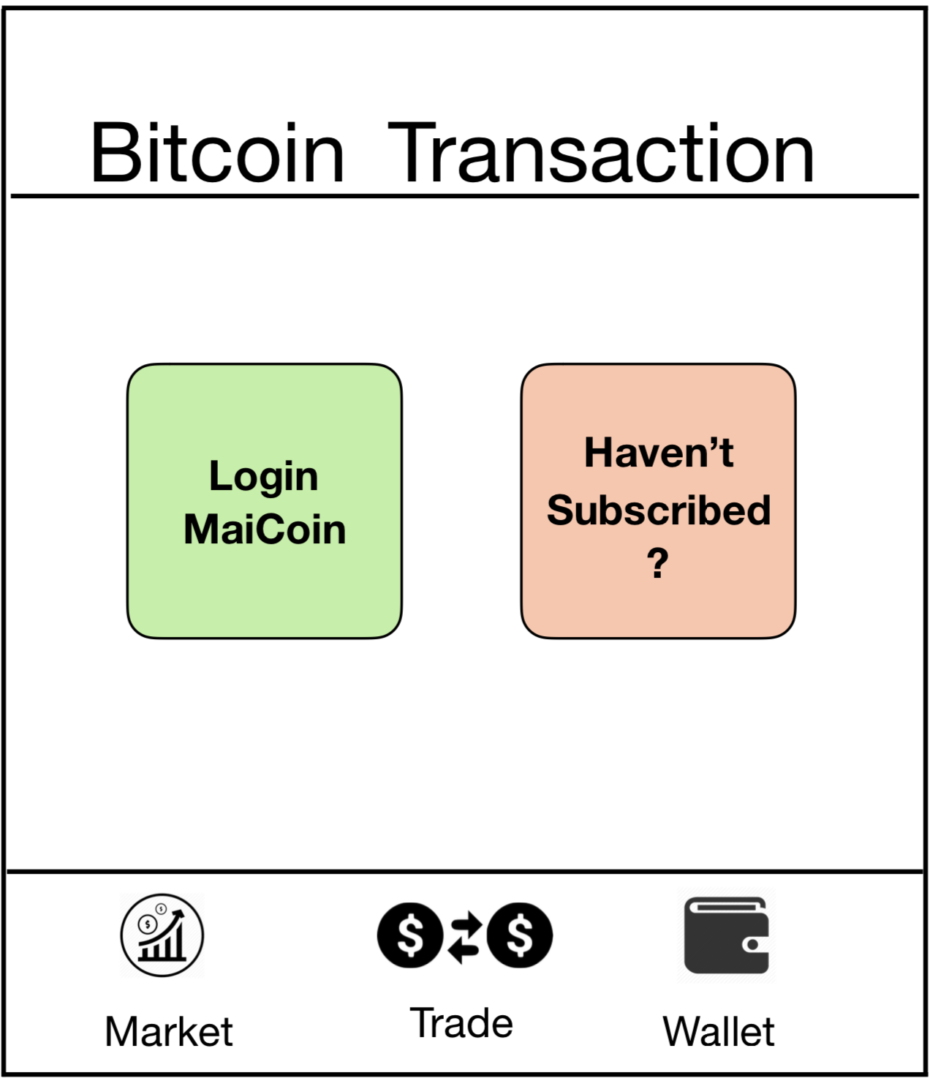
到3

Slide 20
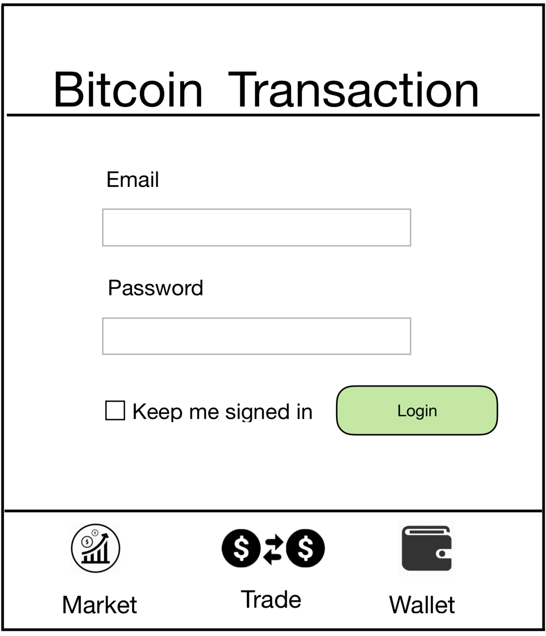

xxxxxxxx@gmail.com
xxxxxxxxxxx
到4

Slide 21
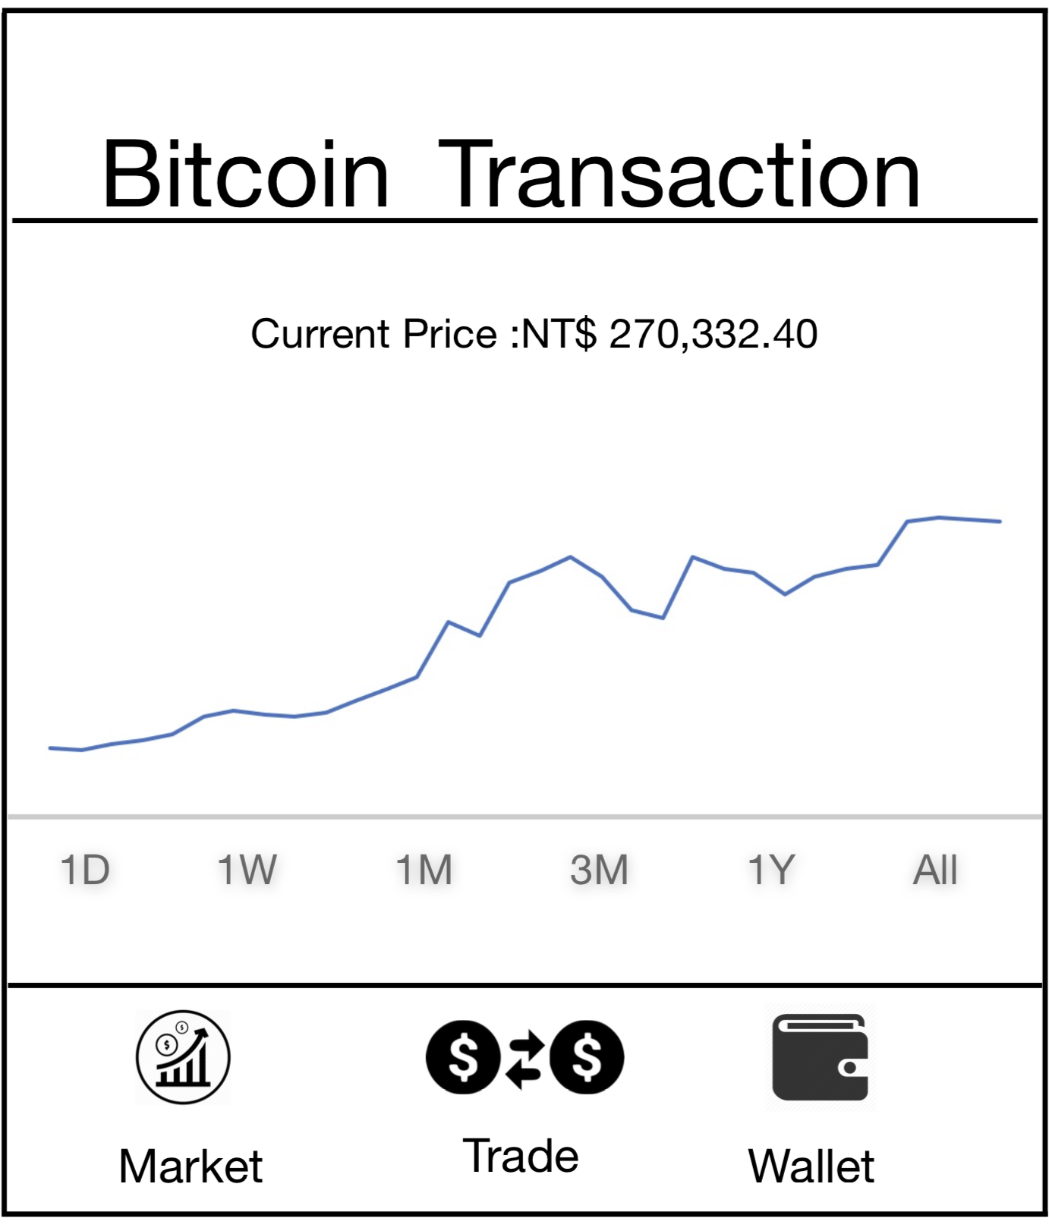
到5

Slide 22
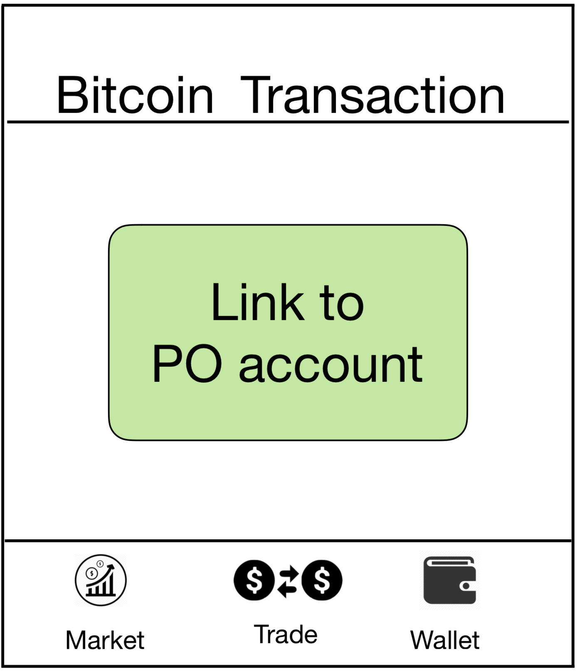
到6

Slide 23
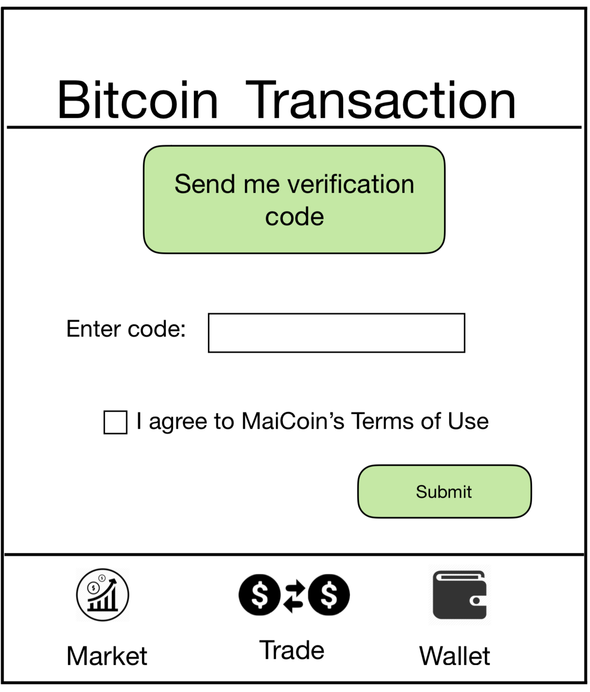

xxxxxx
到7

Slide 24
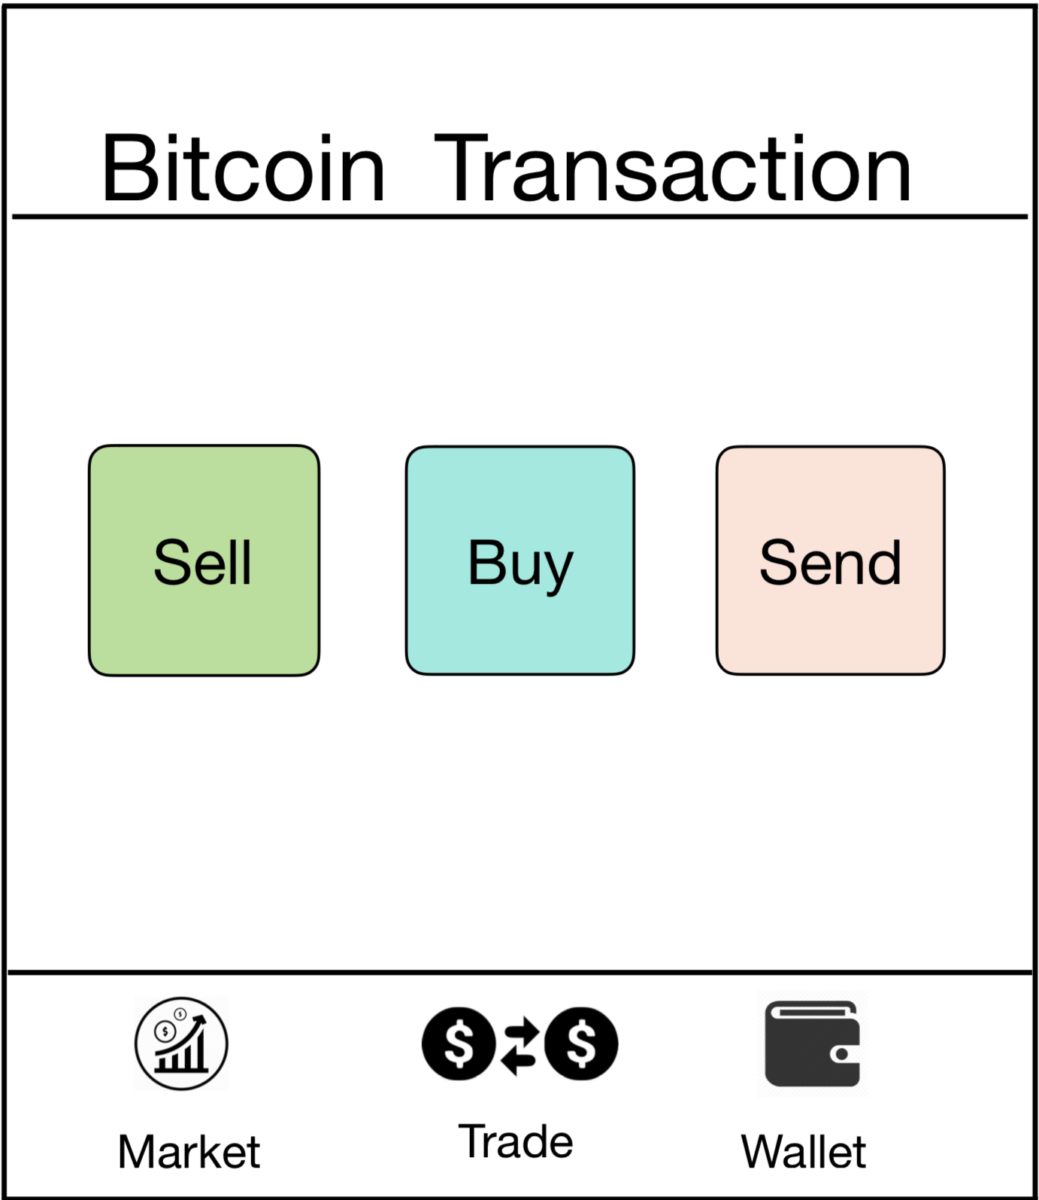
到8
到12
到13

Slide 25
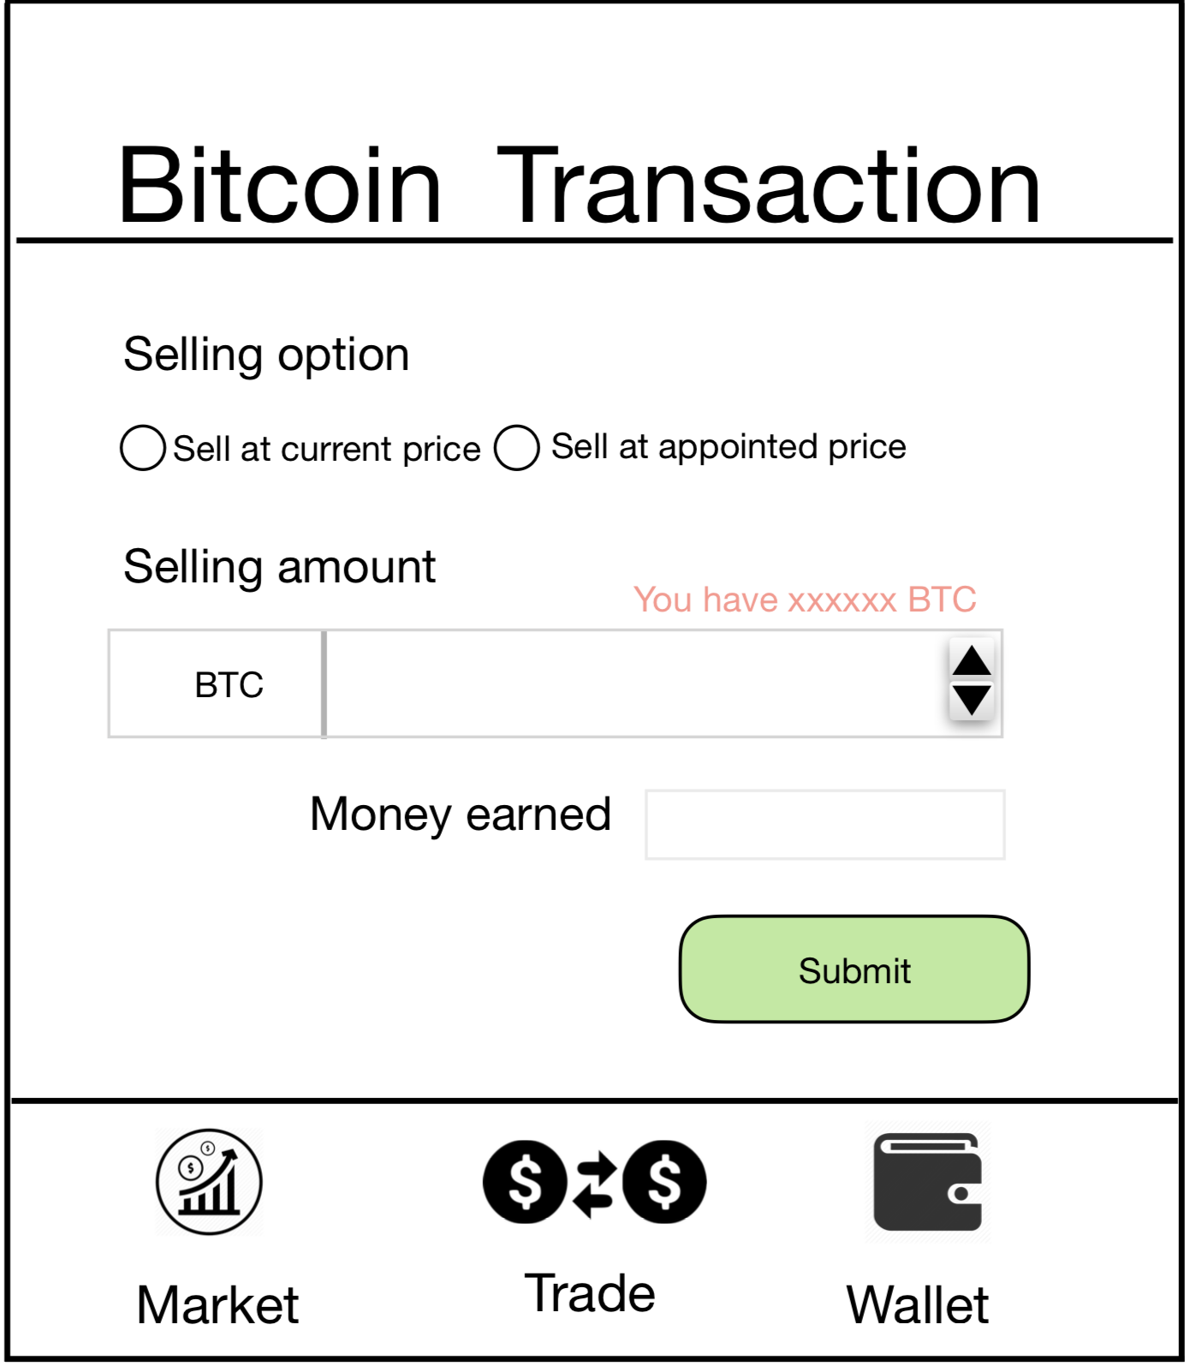
0.5000000
NT
135,166.2
到9

Slide 26
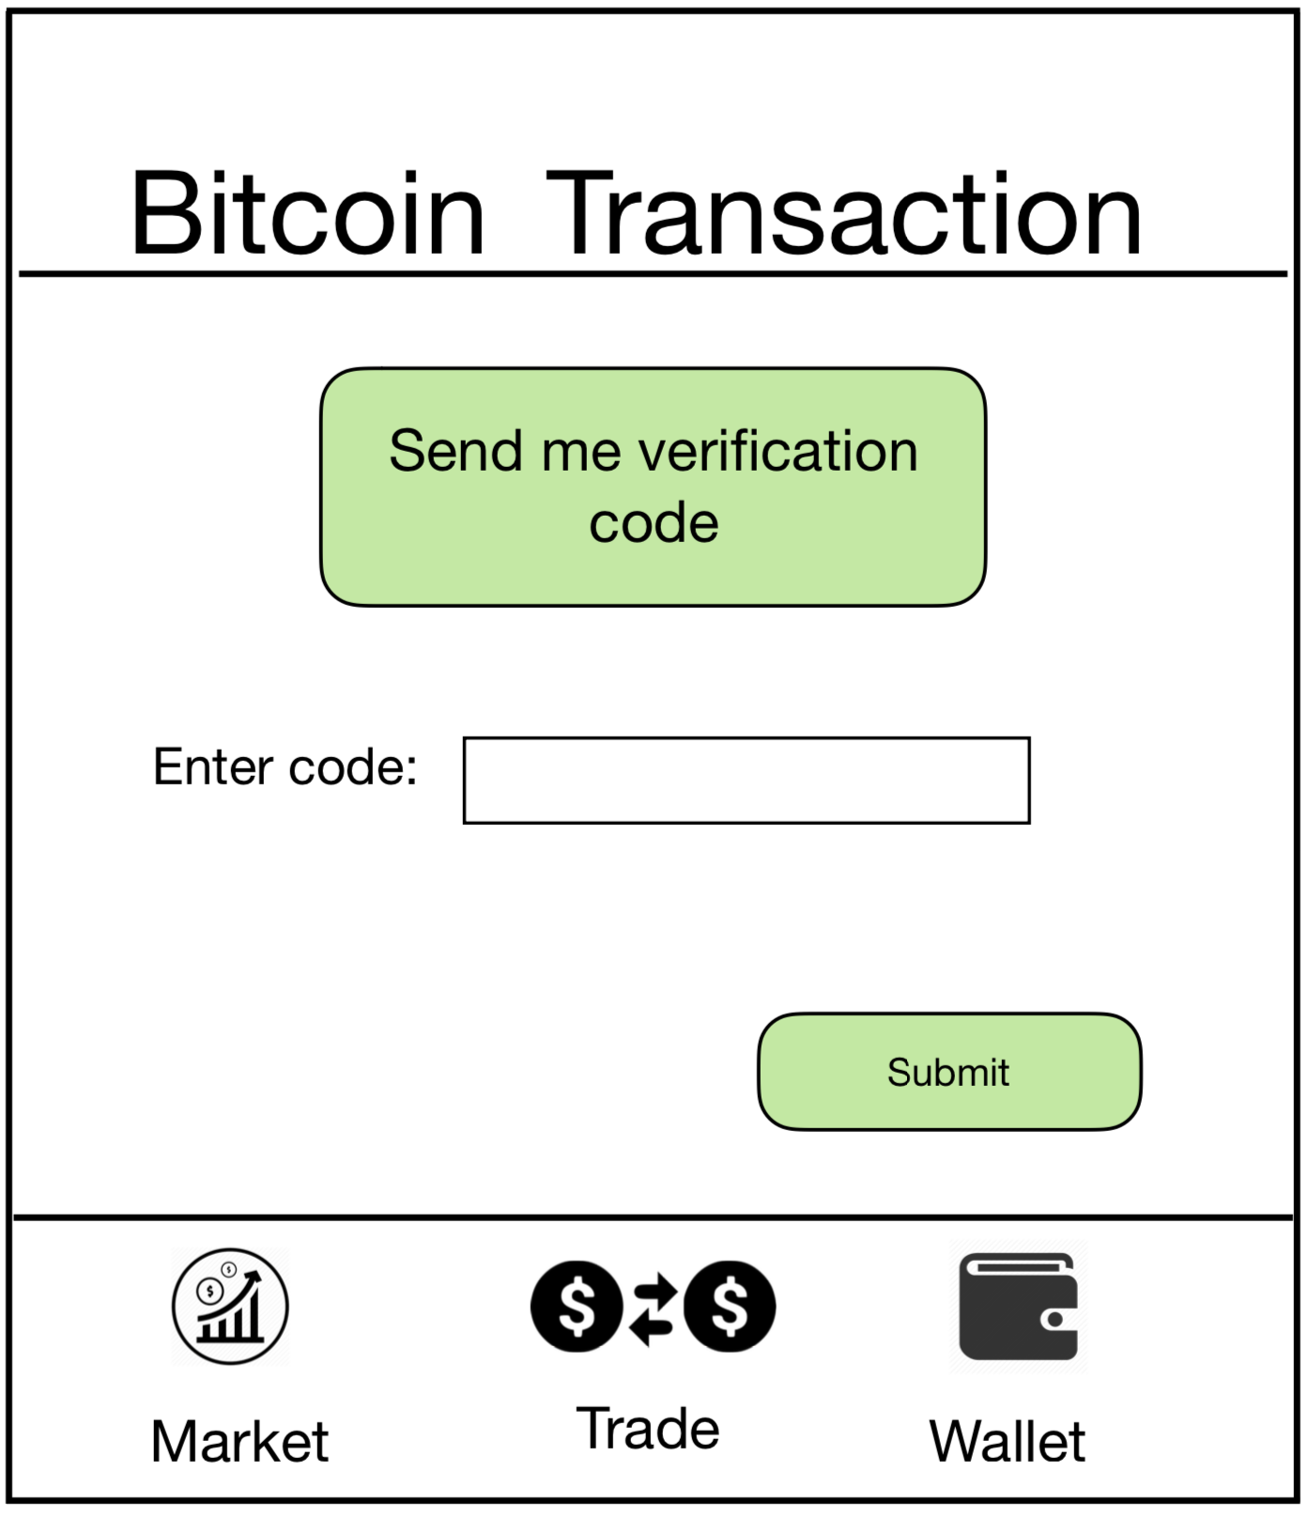

xxxxxx
到11
到10

Slide 27
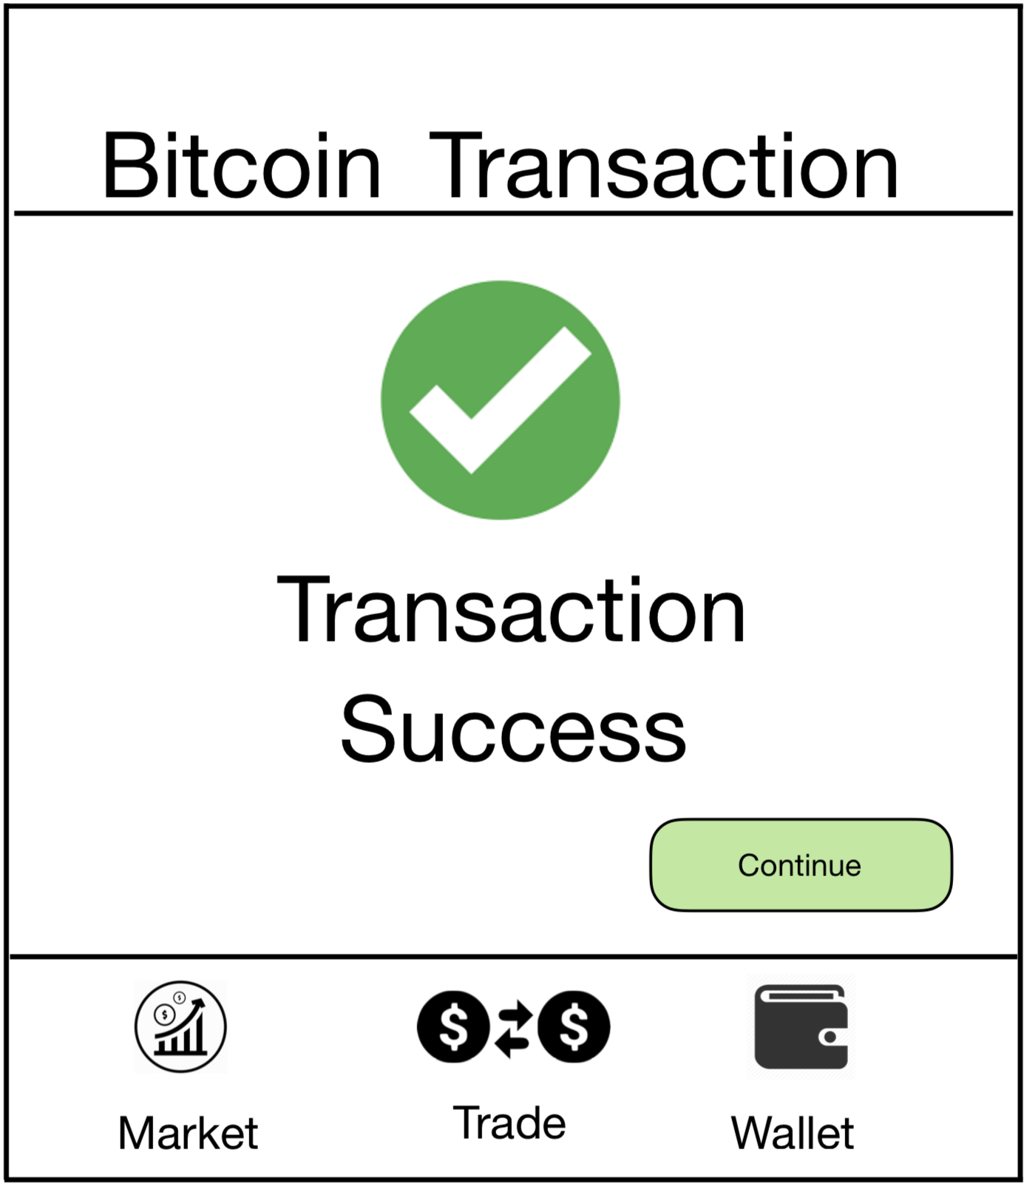
回到7
回到7

Slide 28
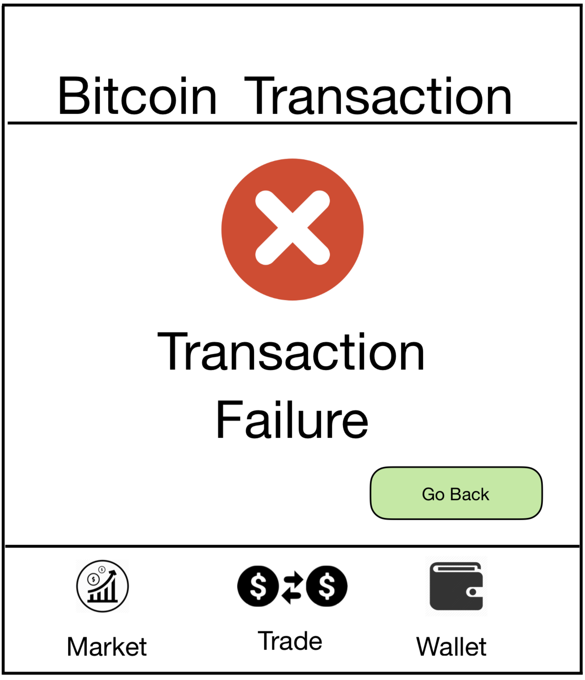
回到9

Slide 29
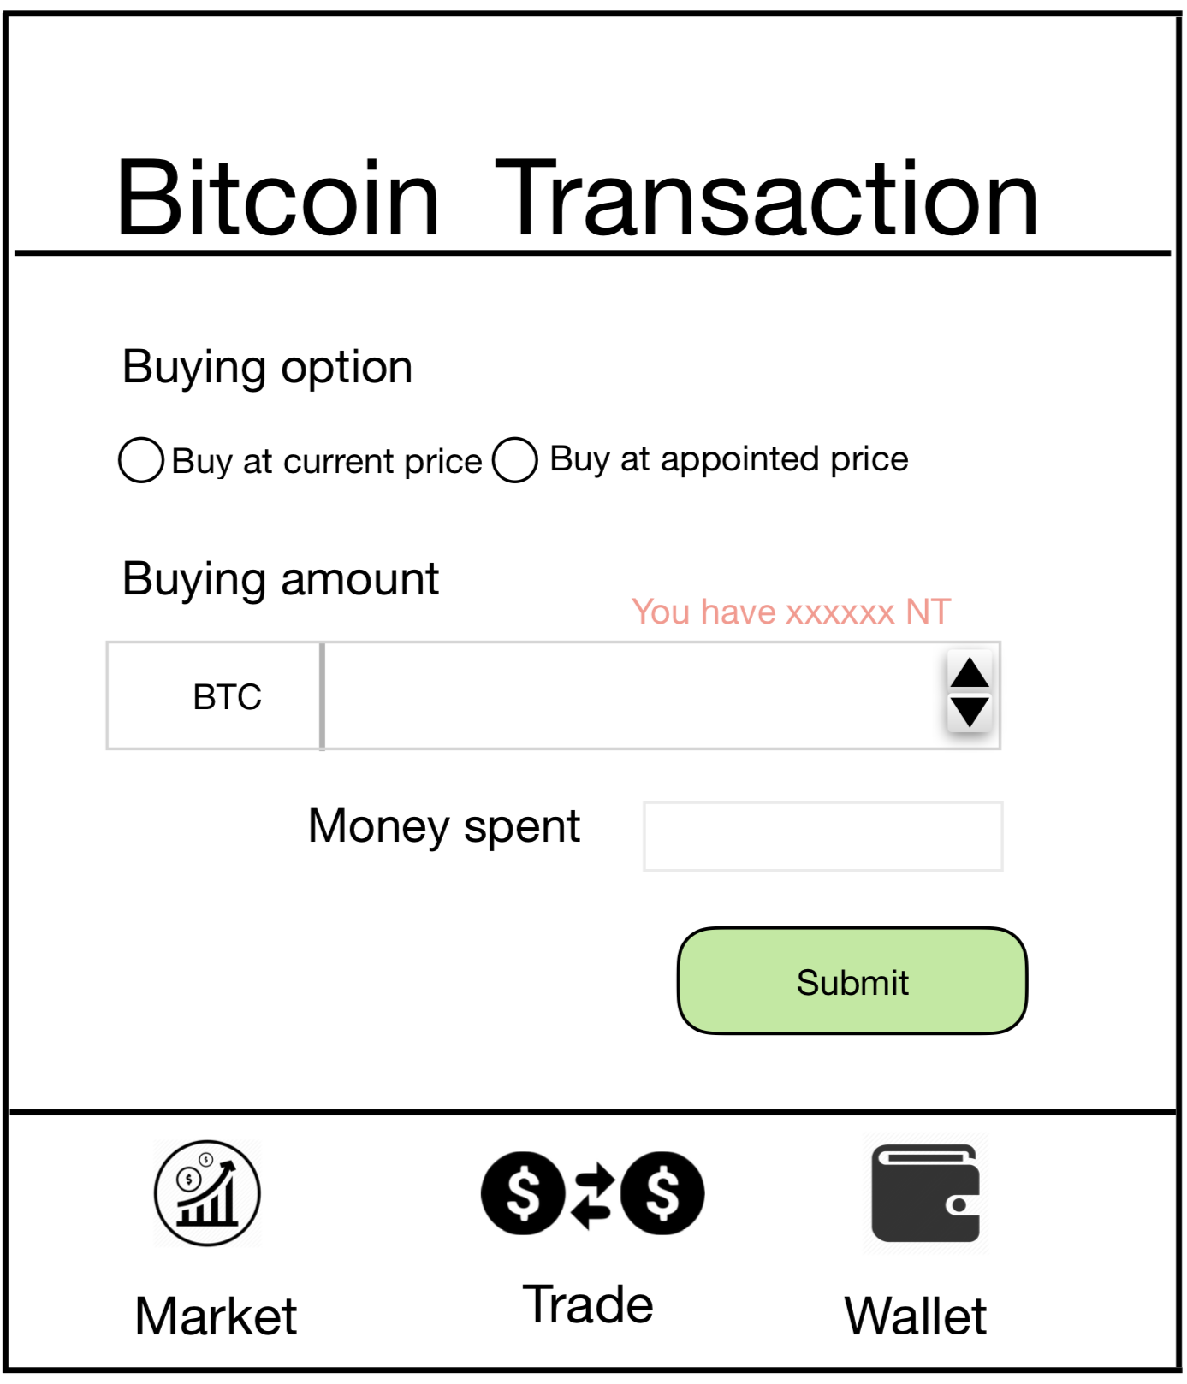
到14
回到7
到14

Slide 30
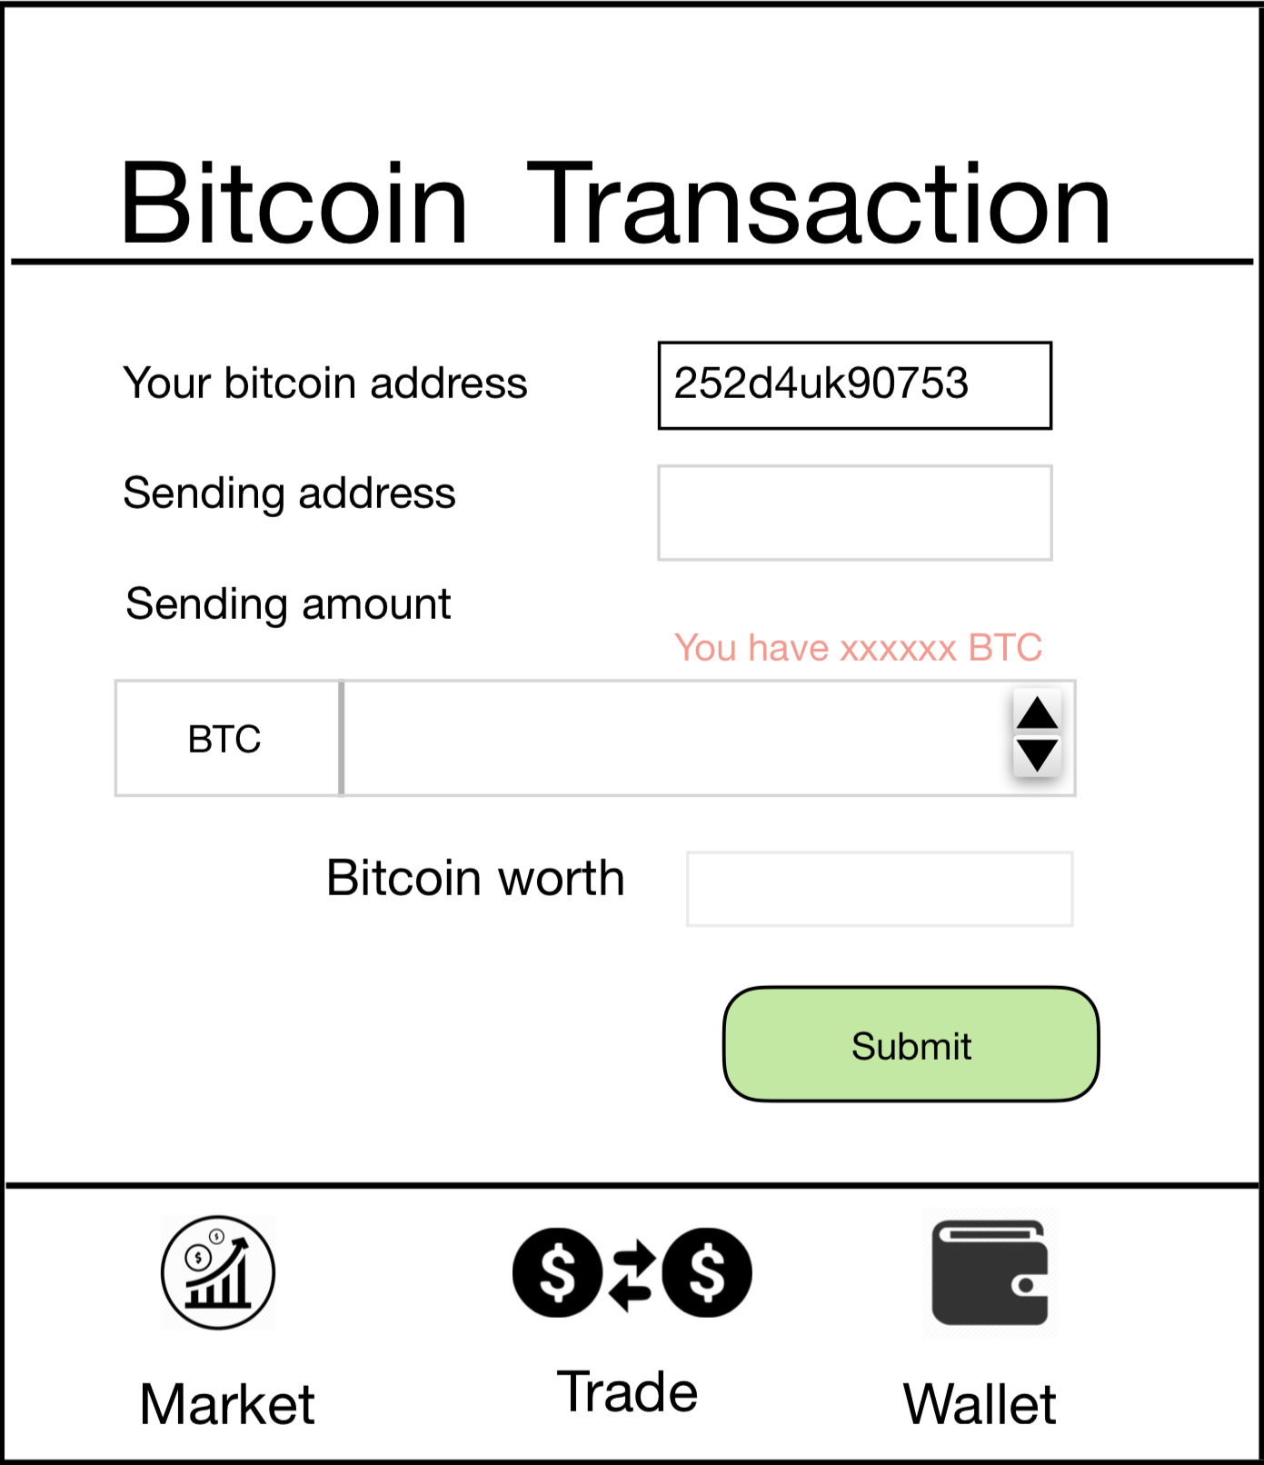

Slide 31
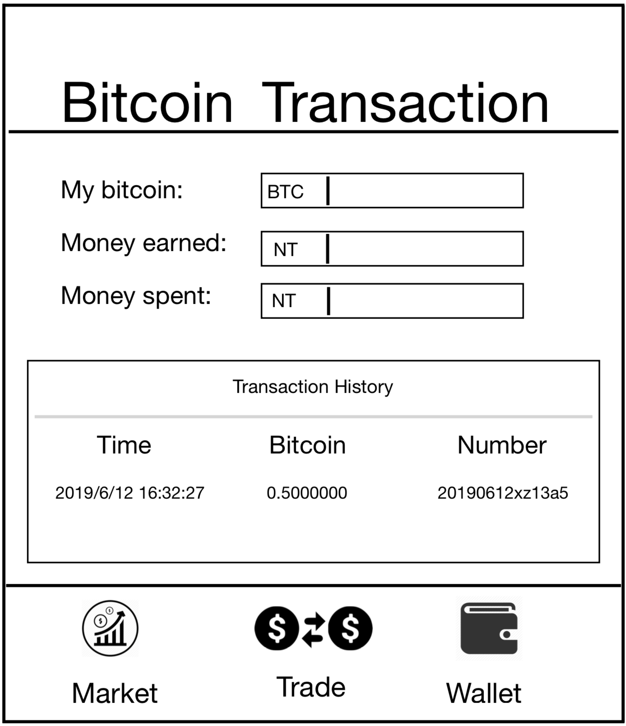
xxxxxxxx
135,166.2
0

Slide 32
Log in & Transaction

Slide 33
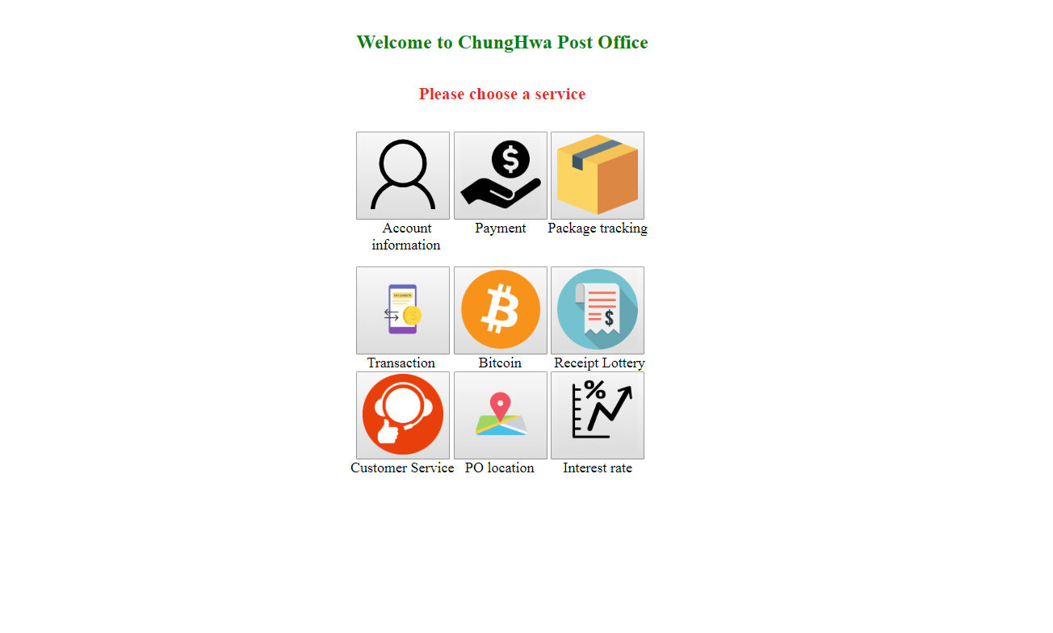

Slide 34
Questions?

